Slide 1
Numerical Methods
Chapter: Interpolation
Dr Akhter Raza

Slide 2
Lecture 20
Introduction to Interpolation
Introduction
Interpolation Problem
Existence and Uniqueness
Linear and Quadratic Interpolation
Newton’s Divided Difference Method
Properties of Divided Differences
Dr Akhter Raza

Slide 3
Introduction
Interpolation was used for long time to provide an estimate of a tabulated function at values that are not available in the table.
What is sin (0.15)?
x | sin(x)
0 | 0.0000
0.1 | 0.0998
0.2 | 0.1987
0.3 | 0.2955
0.4 | 0.3894
Using Linear Interpolation sin (0.15) ≈ 0.1493
True value (4 decimal digits) sin (0.15) = 0.1494
Dr Akhter Raza

Slide 4
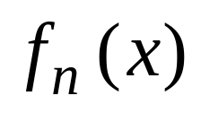
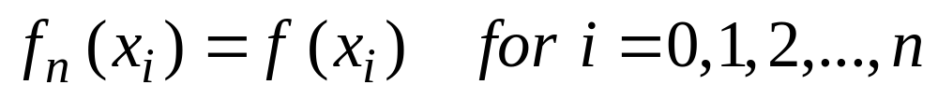
The Interpolation Problem
Given a set of n+1 points,
Find an n^{th} order polynomial
that passes through all points, such that:
Dr Akhter Raza

Slide 5
Example
An experiment is used to determine the viscosity of water as a function of temperature. The following table is generated:
Problem: Estimate the viscosity when the temperature is 8 degrees.
Temperature (degree) | Viscosity
0 | 1.792
5 | 1.519
10 | 1.308
15 | 1.140
Dr Akhter Raza

Slide 6
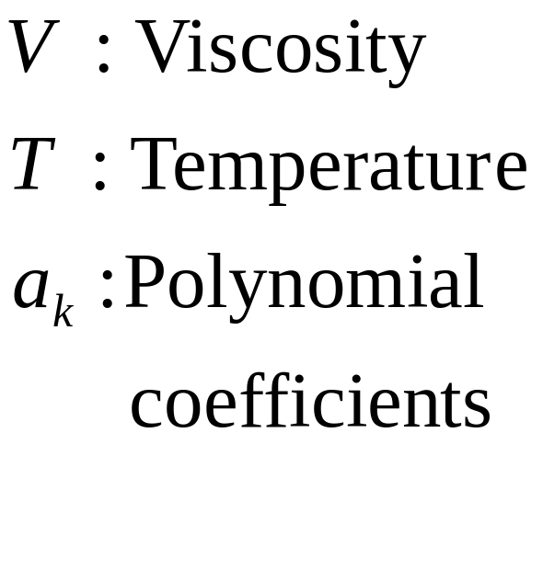
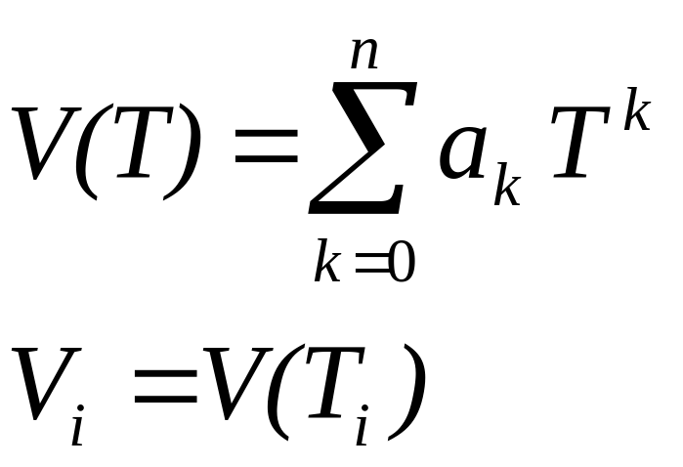
Interpolation Problem
Find a polynomial that fits the data points exactly.
Linear Interpolation: V(T)= 1.73 − 0.0422 T
V(8)= 1.3924
Dr Akhter Raza

Slide 7
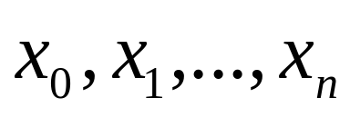
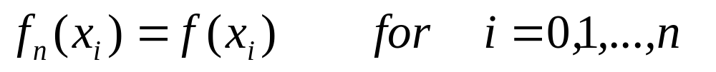
Existence and Uniqueness
Given a set of n+1 points:
Assumption: are distinct
Theorem:
There is a unique polynomial f_{n}(x) of order ≤ n such that:
Dr Akhter Raza

Slide 8
Examples of Polynomial Interpolation
Linear Interpolation
Given any two points, there is one polynomial of order ≤ 1 that passes through the two points.
Quadratic Interpolation
Given any three points there is one polynomial of order ≤ 2 that passes through the three points.
Dr Akhter Raza

Slide 9
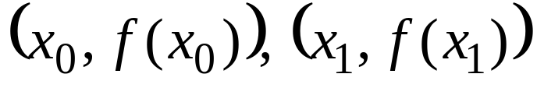
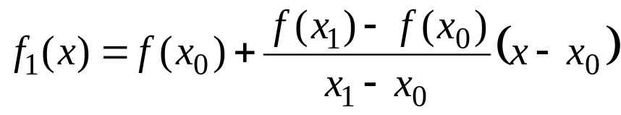
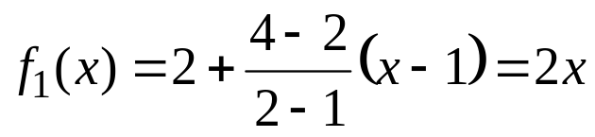
Linear Interpolation
Given any two points,
The line that interpolates the two points is:
Example :
Find a polynomial that interpolates (1,2) and (2,4).
Dr Akhter Raza

Slide 10
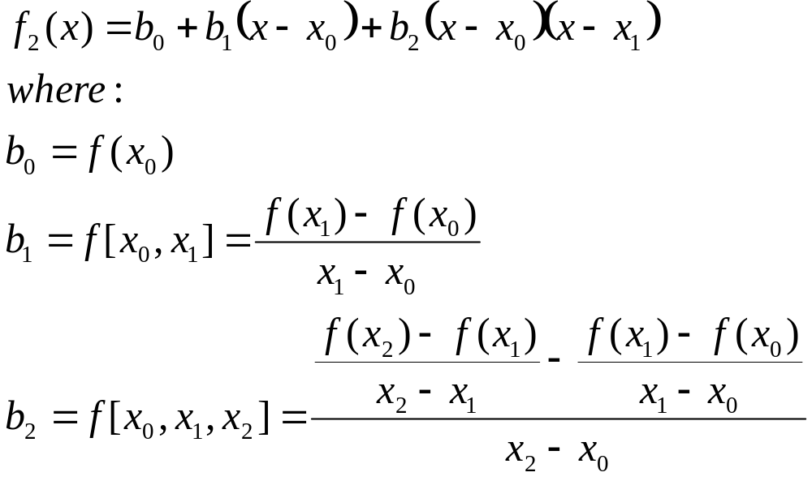
Quadratic Interpolation
Given any three points:
The polynomial that interpolates the three points is:
Dr Akhter Raza

Slide 11

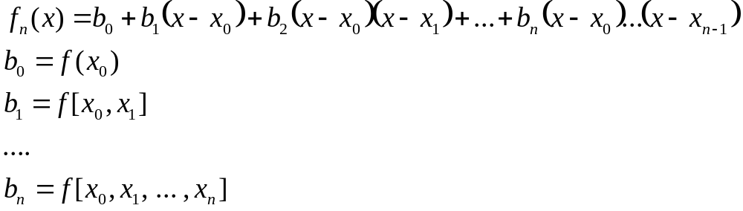
General n^{th} Order Interpolation
Given any n+1 points:
The polynomial that interpolates all points is:
Dr Akhter Raza

Slide 12
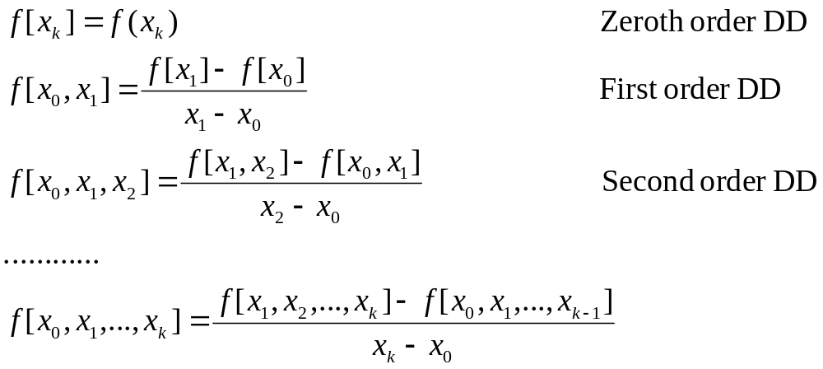
Divided Differences
Dr Akhter Raza

Slide 13
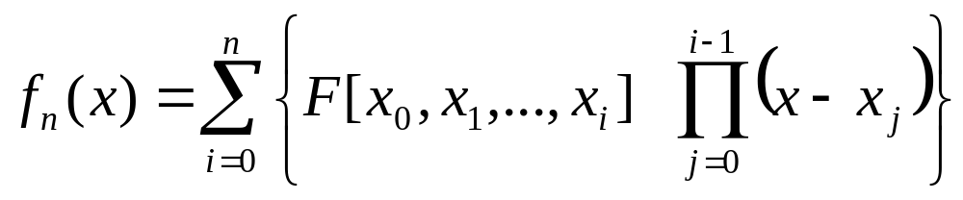
Divided Difference Table
x | F[ ] | F[ , ] | F[ , , ] | F[ , , ,]
x₀ | F[x0] | F[x₀,x₁] | F[x₀,x_{1,}x₂] | F[x₀,x₁,x₂,x₃]
x₁ | F[x₁] | F[x₁,x₂] | F[x₁,x₂,x₃]
x₂ | F[x₂] | F[x₂,x₃]
x₃ | F[x₃]
Dr Akhter Raza

Slide 14

Divided Difference Table
x | F[ ] | F[ , ] | F[ , , ]
0 | -5 | 2 | -4
1 | -3 | 6
-1 | -15
 | f(x_{i})
0 | -5
1 | -3
-1 | -15
Entries of the divided difference table are obtained from the data table using simple operations.
Dr Akhter Raza

Slide 15
Divided Difference Table
x | F[ ] | F[ , ] | F[ , , ]
0 | -5 | 2 | -4
1 | -3 | 6
-1 | -15
 | f(x_{i})
0 | -5
1 | -3
-1 | -15
The first two column of the
table are the data columns.
Third column: First order differences.
Fourth column: Second order differences.
Dr Akhter Raza

Slide 16

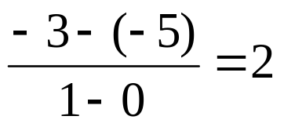
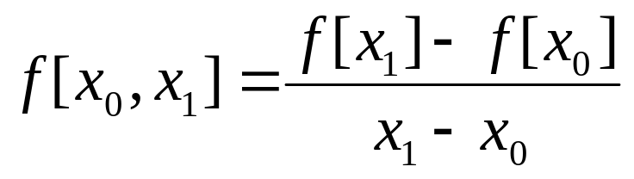
Divided Difference Table
0 | -5
1 | -3
-1 | -15
x | F[ ] | F[ , ] | F[ , , ]
0 | -5 | 2 | -4
1 | -3 | 6
-1 | -15
Dr Akhter Raza

Slide 17
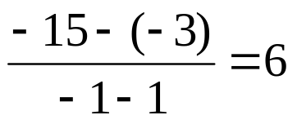
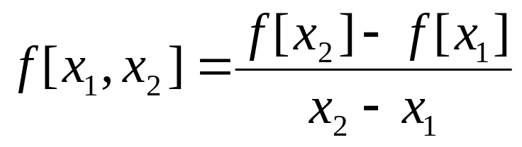
Divided Difference Table
0 | -5
1 | -3
-1 | -15
x | F[ ] | F[ , ] | F[ , , ]
0 | -5 | 2 | -4
1 | -3 | 6
-1 | -15
Dr Akhter Raza

Slide 18
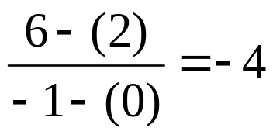
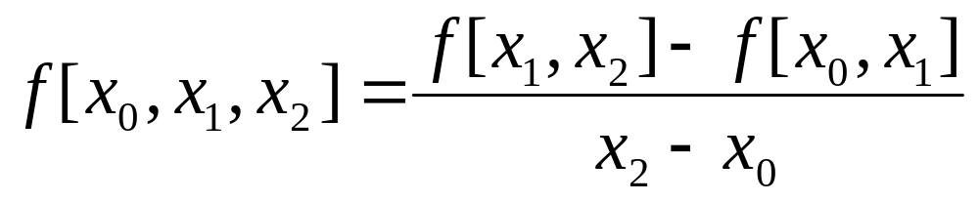
Divided Difference Table
0 | -5
1 | -3
-1 | -15
x | F[ ] | F[ , ] | F[ , , ]
0 | -5 | 2 | -4
1 | -3 | 6
-1 | -15
Dr Akhter Raza

Slide 19
Divided Difference Table
0 | -5
1 | -3
-1 | -15
x | F[ ] | F[ , ] | F[ , , ]
0 | -5 | 2 | -4
1 | -3 | 6
-1 | -15
f₂(x)= F[x₀]+F[x₀,x₁] (x-x₀)+F[x₀,x₁,x₂] (x-x₀)(x-x₁)
Dr Akhter Raza

Slide 20
Two Examples
Obtain the interpolating polynomials for the two examples:
x | y
1 | 0
2 | 3
3 | 8
x | y
2 | 3
1 | 0
3 | 8
What do you observe?
Dr Akhter Raza

Slide 21
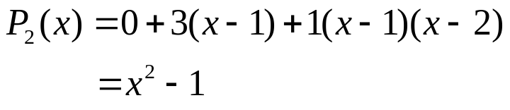

Two Examples
x | Y
1 | 0 | 3 | 1
2 | 3 | 5
3 | 8
x | Y
2 | 3 | 3 | 1
1 | 0 | 4
3 | 8
Ordering the points should not affect the interpolating polynomial.
Dr Akhter Raza

Slide 22
Properties of Divided Difference
Ordering the points should not affect the divided difference:
Dr Akhter Raza

Slide 23
Example
Find a polynomial to interpolate the data.
x | f(x)
2 | 3
4 | 5
5 | 1
6 | 6
7 | 9
Dr Akhter Raza

Slide 24
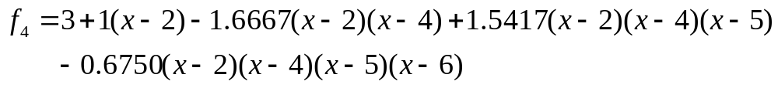
Example
x | f(x) | f[ , ] | f[ , , ] | f[ , , , ] | f[ , , , , ]
2 | 3 | 1 | -1.6667 | 1.5417 | -0.6750
4 | 5 | -4 | 4.5 | -1.8333
5 | 1 | 5 | -1
6 | 6 | 3
7 | 9
Dr Akhter Raza

Slide 25
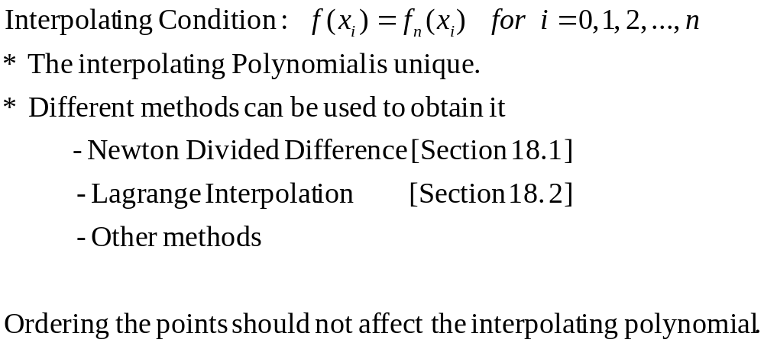
Summary
Dr Akhter Raza

Slide 26
Lecture 21
Lagrange Interpolation
Dr Akhter Raza

Slide 27
The Interpolation Problem
Given a set of n+1 points:
Find an n^{th} order polynomial:
that passes through all points, such that:
Dr Akhter Raza

Slide 28








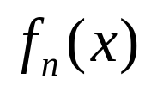

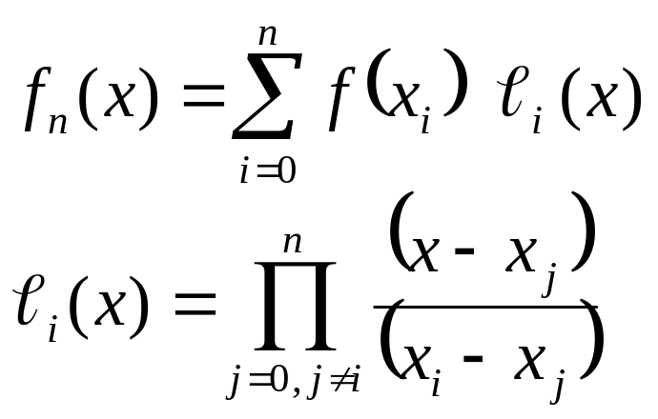
Lagrange Interpolation
Problem:
Given
Find the polynomial of least order such that:
Lagrange Interpolation Formula:
 |  |  | ….
 |  |  | ….
Dr Akhter Raza

Slide 29
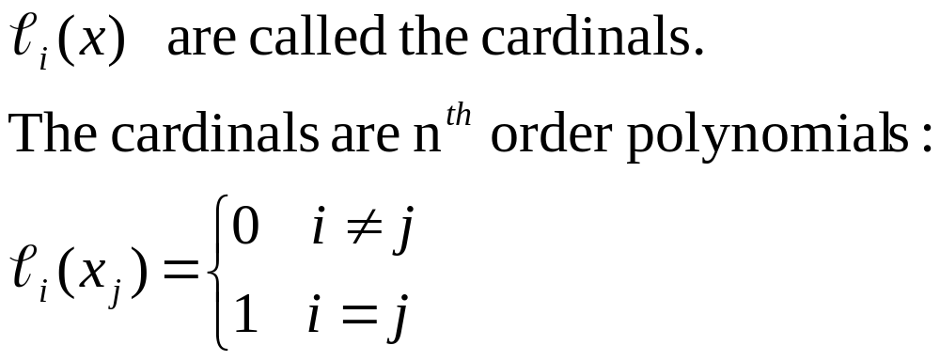
Lagrange Interpolation
Dr Akhter Raza

Slide 30
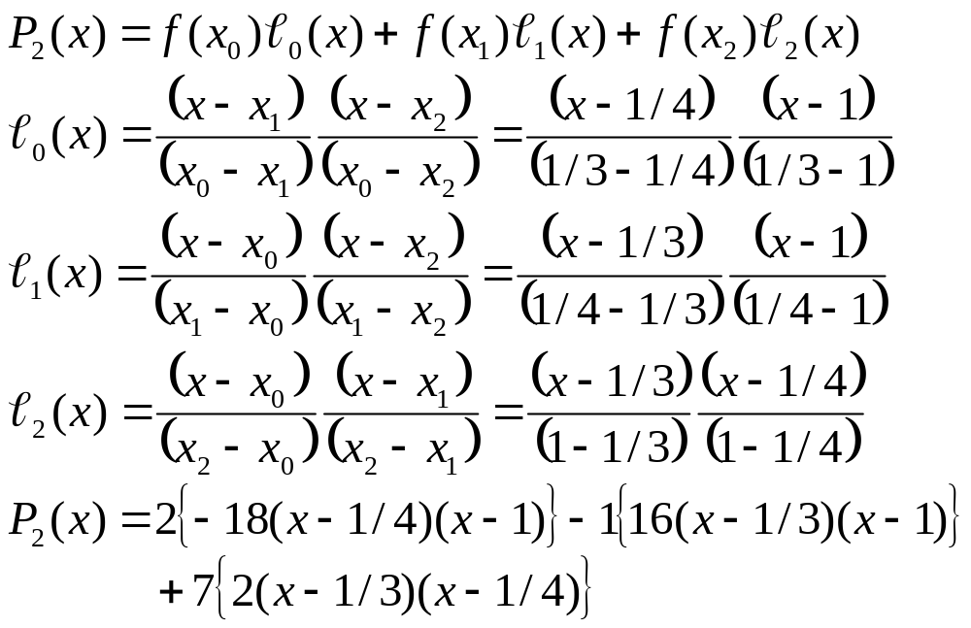
Lagrange Interpolation Example
x | 1/3 | 1/4 | 1
y | 2 | -1 | 7
Dr Akhter Raza

Slide 31
Example
Find a polynomial to interpolate:
Both Newton’s interpolation method and Lagrange interpolation method must give the same answer.
x | y
0 | 1
1 | 3
2 | 2
3 | 5
4 | 4
Dr Akhter Raza

Slide 32
Newton’s Interpolation Method
0 | 1 | 2 | -3/2 | 7/6 | -5/8
1 | 3 | -1 | 2 | -4/3
2 | 2 | 3 | -2
3 | 5 | -1
4 | 4
Dr Akhter Raza

Slide 33
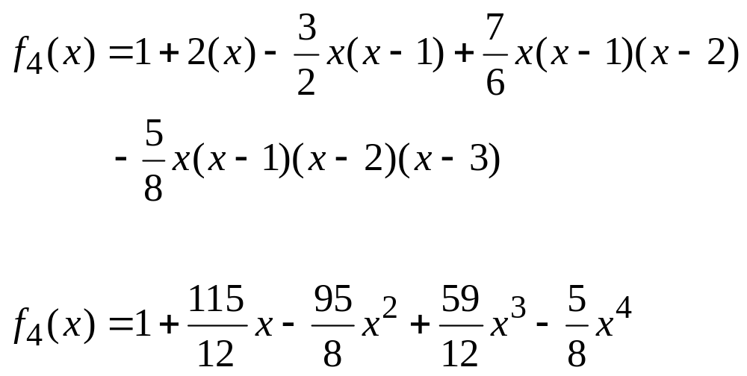
Interpolating Polynomial
Dr Akhter Raza

Slide 34
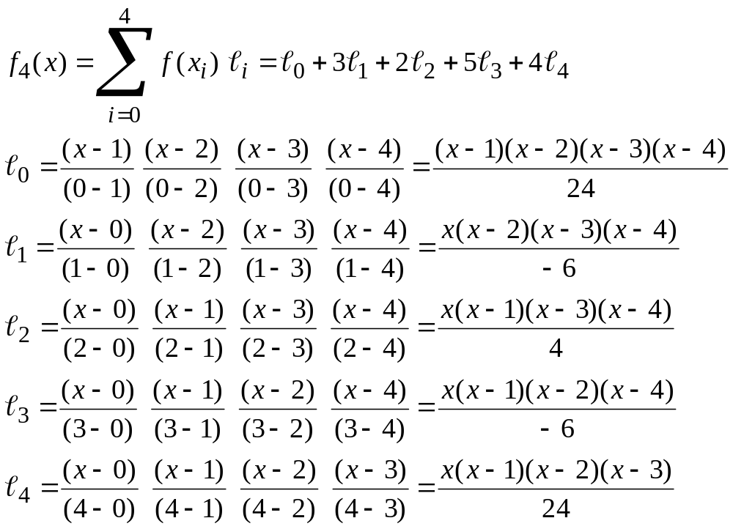
Interpolating Polynomial Using Lagrange Interpolation Method
Dr Akhter Raza

Slide 35
Summary
The interpolating polynomial is unique.
Different methods can be used to obtain it.
  Newton’s divided difference
  Lagrange interpolation
  Others
Polynomial interpolation can be sensitive to data.
BE CAREFUL when high order polynomials are used.
Dr Akhter Raza

